Slide 1
FLYWEIGHT Pattern
Flyweight pattern is Structural Design Pattern.
Flyweight pattern is used to reduce the number of objects created, to decrease memory and resource usage. As a result it increase performance.
It try to reuse already existing similar kind objects by storing them and creates new object when no matching object is found.

Slide 2
Flyweight pattern contains three members
Flyweight interface.
ConcreteFlyweight class
FlyweightFactory class

Slide 3
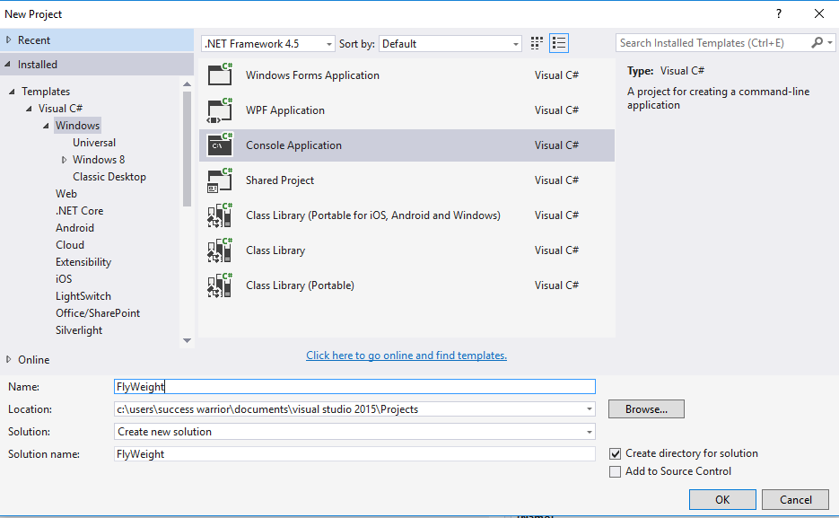

Slide 4
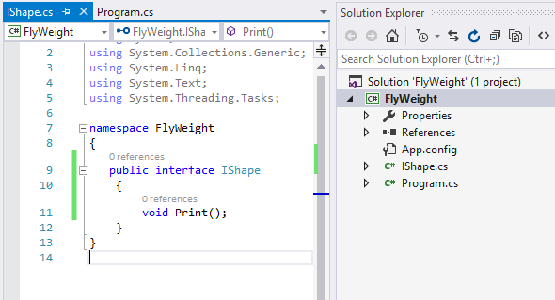

Slide 5
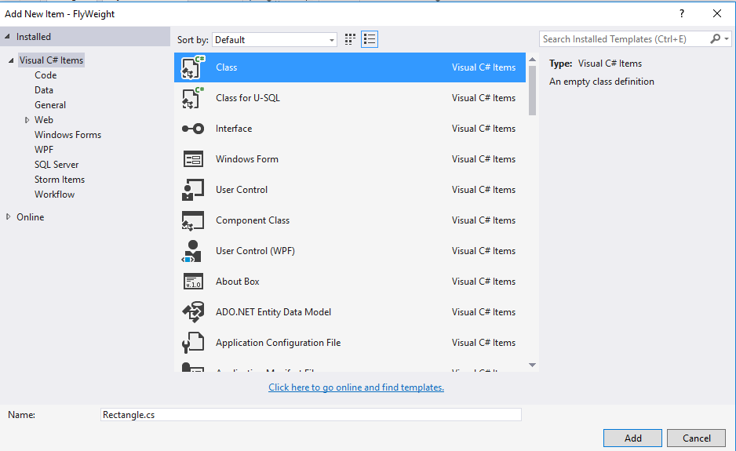

Slide 6
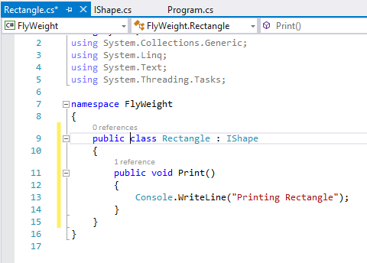

Slide 7
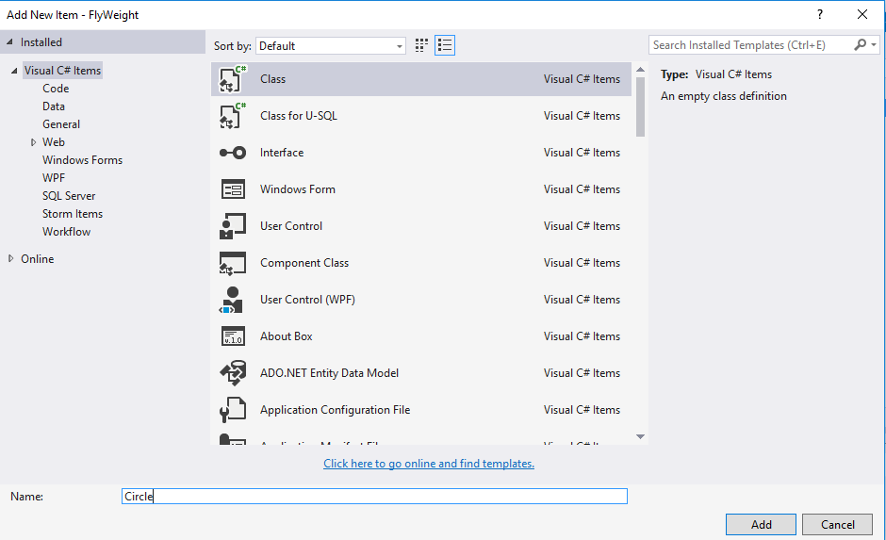

Slide 8
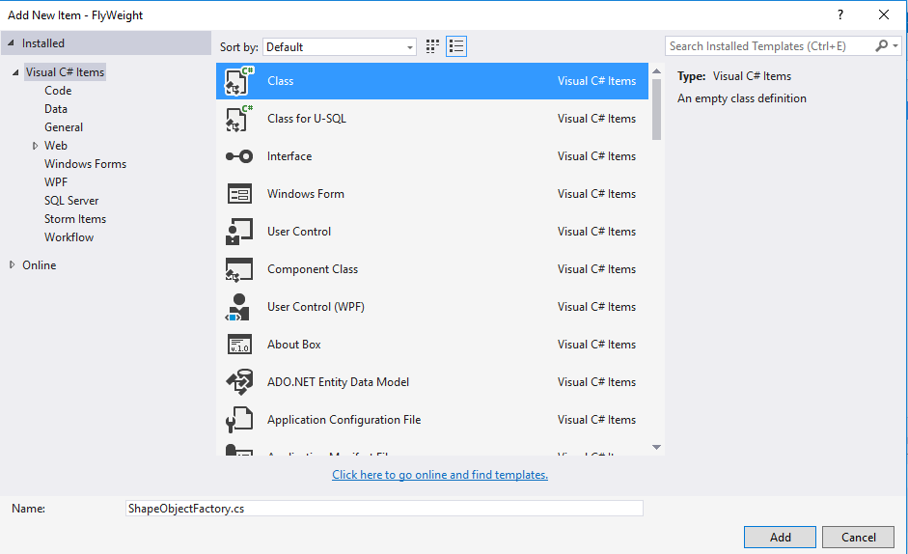

Slide 9
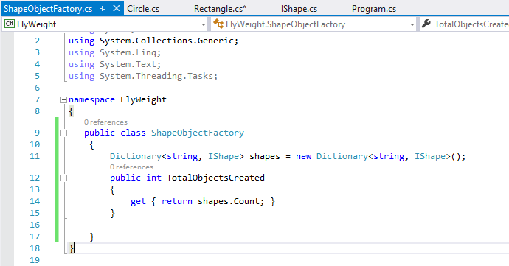

Slide 10
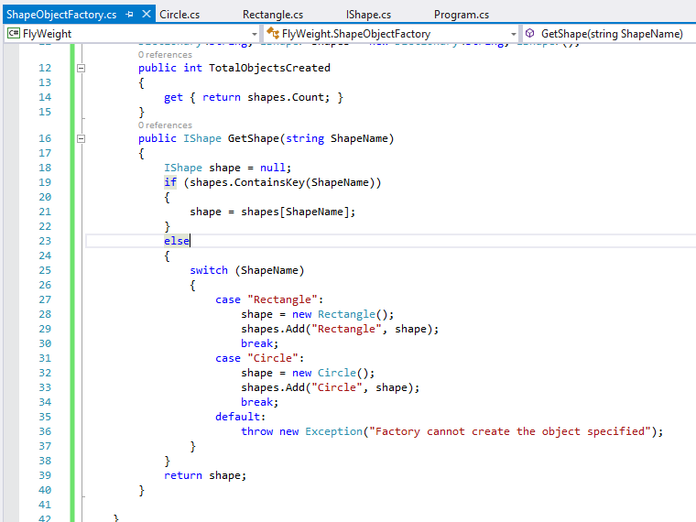

Slide 11
